Slide 1

RDC Summit 2022
4th - 6th December 2022
The Everly Hotel, Putrajaya
MALAYSIA
Contact Us
RDC Summit Secretariat
Email: info@rdc.asia
www.rdc.asia/summit

Slide 2


Slide 3
INTRODUCTION
Regional Development Community Berhad (RDC) is a Muslim philanthropic organisation established with the aim of creating sustainable communities holistically across the Asia Pacific region.
RDC collaborates with identified Asia Pacific partners on community engagements and development projects which align with selected United Nation’s Sustainable Development Goals (SDGs).
Currently, RDC engages more than 30 Non-Governmental Organizations (NGOs) in 30 Asia Pacific countries. RDC Summit aims to streamline our efforts and bring together all the NGOs involved. It is also an effort to encourage the business fraternities in all the countries to network and support each other.

Slide 4
SYNOPSIS
RDC Summit 2022 will feature these events during three concurrent conferences:
RDC Women Empowerment Conference 2022 (RDC WEC22) on December 4. This event is in collaboration with Wanita IKRAM Malaysia.
RDC Humanitarian Conference 2022 (RDC HC22) on December 4, held in collaboration with Humanitarian Care Malaysia Berhad (MyCARE).
RDC Business Conference 2022 (RDCBIZ22), on the 5th and 6th of December, in collaboration with Muslim Business Network Association of Malaysia (MUBIN) and the Economic Empowerment Unit, Pertubuhan IKRAM Malaysia (UPE).
RDC Summit Dinner on December 4th.
Expo on the 5th and 6th of December.

Slide 5
OBJECTIVE
RDC Summit 2022 is expected to accomplish the following objectives:
To get the involvement of NGOs in the Asia Pacific region to engage in community development agendas in a planned and comprehensive manner.
To bring together NGOs and individuals involved in women empowerment agenda, humanitarian work and economic development.
To upscale women leadership, humanitarian and business initiatives to ensure their effective roles in community development.
To develop strategic plans to help raise the standard of living of the Asia Pacific communities through projects implemented by RDC and its partners.

Slide 6
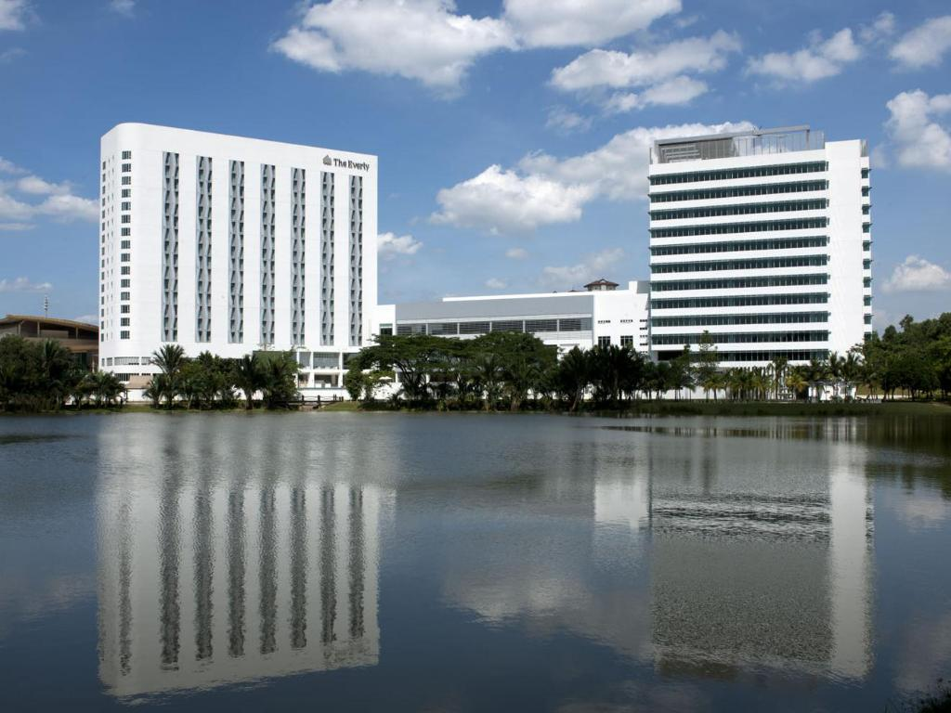
VENUE & DATE
The Everly Hotel, Putrajaya
4th - 6th December 2022

Slide 7
RDC Summit | OVERALL SCHEDULES
EVENTS | DAY 1: 4 Dec 2022 (Sunday) | DAY 2: 5 Dec 2022 (Monday) | DAY 3: 6 Dec 2022 (Tuesday)
RDC WEC22 | x
RDC HC22 | x
Dinner | x
RDCBIZ22 |  | x | x
Exhibition |  | x | x
Biz Matching |  | x | x

Slide 8

ABOUT | RDC WEC22
Empowering Women, Developing Communities

Slide 9
ABOUT | RDC WEC22
OBJECTIVES
To create awareness on business digitalisation solutions for women entrepreneurs that are feasible, practical and sustainable.
To exchange ideas on strategies and programmes so that it can catalyse Asia Pacific business women towards digitalising their business platforms.
To establish the available networking opportunities that support women entrepreneurs in the Asia Pacific countries.

Slide 10

HIGHLIGHTS: RDC WEC22
Plenary 1
Introduction to Digitalization & Business Strength in ASEAN Countries
Plenary 2
ASEAN Digital Masterplan 2025
Plenary 3
Smart Financing: Microfinance, Microloan, Microcredit: Which One Do You Need?
Plenary 4
Traditional VS Smart Finance: “Challenges and Benefits”
Plenary 5
Women Entrepreneur Showcase

Slide 11

ABOUT | RDC HC22
Promoting Humanitarian agenda as a necessity

Slide 12
ABOUT | RDC HC22
OBJECTIVES
1. To share information about humanitarian work.
2. To discuss appropriate approaches to humanitarian assistance.
3. To give recommendations on best practices.
4. To discuss and outline the fundamental requirements of humanitarian work.

Slide 13
HIGHLIGHTS: RDC HC22
Session 1
Introduction to Sustainable Development Goals
Session 2
Introduction to Standards and Good Governance
Session 3
Critical Success Factors in Running A Humanitarian Organisation:
A Sri Lanka Experience
Session 4
Effective Humanitarian Relief in Minority Muslim Countries

Slide 14

ABOUT | RDCBIZ22
Business Opportunities and Challenges in Implementing Sustainable Development Goals (SDGs) Initiatives in the Asia Pacific Region

Slide 15
ABOUT | RDCBIZ22
OBJECTIVES
To enhance network and strategic engagements amongst businessmen and community leaders in the Asia Pacific region.
To mind-map a strategic plan for sustainable communities agenda in the region.
To empower all participants with knowledge-based, data-driven and best practices approach in the new age of business ventures and community developments
To leverage from key players and experts in social entrepreneurship.
To review the 2019 RDCBIZ convention’s Resolution.

Slide 16
HIGHLIGHTS: RDCBIZ22
3 Keynote Addresses
2 Forums
6 Business Showcases
Business Matching
MoU Signing
Exhibition

Slide 17
SPONSORSHIP PACKAGES

Slide 18
RDC WEC22 SPONSORSHIP
Package | Slot | Amount
RUBY | 1 | RM30,000
SAPPHIRE | 1 | RM20,000
EMERALD | 2 | RM10,000

Slide 19
SPONSORSHIP: RDC WEC22
SPONSORSHIP BENEFITS
BENEFITS | RUBY 30,000 | SAPPHIRE 20,000 | EMERALD 10,000
Branding Exposure
Company logo in poster and marketing material | x | x | x
Company video promo/corporate video to be played during intermittent of program | x | x | x
Advertisement in RDC portal | x | x | x
Officiating WEC | x

Slide 20
SPONSORSHIP: RDC WEC22
SPONSORSHIP BENEFITS
BENEFITS | RUBY 30,000 | SAPPHIRE 20,000 | EMERALD 10,000
Access
WEC Conference Passes | 2 | 2 | 2
WEC Online Passes | 10 | 4 | 2
RDC Summit Dinner Passes | 6 | 4 | 2

Slide 21
RDC HC22 SPONSORSHIP
Package | Slot | Amount
BLUE | 1 | RM15,000
GREEN | 2 | RM10,000
RED | 2 | RM5,000

Slide 22
SPONSORSHIP: RDC HC22
SPONSORSHIP BENEFITS
BENEFITS | BLUE 15,000 | GREEN 10,000 | RED 5,000
Branding Exposure
Co-Branded Logo With RDC HC22 Logo | x | x
Access
HC Conference Passes | 2 | 2 | 2
RDC Summit Dinner Passes | 3 | 2 | 1

Slide 23
SPONSORSHIP: RDCBIZ22
SPONSORSHIP BENEFITS

Slide 24
BENEFITS | PLATINUM 50,000 (1 slot) | DIAMOND 30,000 (2 slots) | GOLD 20,000 (4 slots) | SILVER 10,000 (6 slots) | BRONZE 5000 (10 slots)
Physical Branding | X | X | X | X | X
●Branding on all RDC Summit events, activities & advertising signages ●Branding on non woven bags & lanyards ●Logo on all marketing collaterals & event directory ●Logo on event backdrop & bunting 250 words + company logo write-up ●1 inner cover advert & full page write up on event directory
Branding Exposure | X | X
●Co-Branded Logo With Event Logo ●VIP seat (1) for RDC Summit Launching ●Up to 5 minutes onsite video interview to be included in post event video ●Company promotion video during breaks

Slide 25
BENEFITS | PLATINUM 50,000 (1 slot) | DIAMOND 30,000 (2 slots) | GOLD 20,000 (4 slots) | SILVER 10,000 (6 slots) | BRONZE 5000 (10 slots)
Digital Branding | X | X | X | X | X
●Promotion on RDC Summit official website as a sponsor ●RDC Summit social media announcement of sponsorship ●Logo incorporated in all RDC Summit e-newsletters ●Profile on website
Speaking Opportunities | X | X
●Day 1 - Plenary Session (20 minutes)

Slide 26
BENEFITS | PLATINUM 50,000 (1 slot) | DIAMOND 30,000 (2 slots) | GOLD 20,000 (4 slots) | SILVER 10,000 (6 slots) | BRONZE 5000 (10 slots)
Access
●Dinner passes | 10 | 6 | 4 | 2 | 1
●WEC Passes | 2 | 2
●Humanitarian Passes | 2 | 2
●RDCBIZ Passes | 10 | 5 | 3 | 2 | 2
Delegate list with contact details | X | X | X | X | X
Exhibition Booth | X | X | X
Conference Bag Inserts | X

Slide 27
THE ORGANISING TEAM
RDC SUMMIT 2022 | Haji Wan Ahmad Nizar Zakaria wanizar@gmail.com +6012-3052505
WEC 2022 Program Manager | Saidatul Syuhada Ahmad Shukri syuhada.schluessel@gmail.com +6019-6532688
HC 2022 Program Manager | Abdul Hafidz Hashim apitns@gmail.com +6019-3566760
RDCBIZ 2022 Program Manager | Abdul Hafidz Hashim apitns@gmail.com +6019-3566760

Slide 28

BLOCK THE DATES
1st RDC SUMMIT 2022
RDC Women Empowerment Conference (RDC WEC22)
RDC Humanitarian Conference (RDC HC22)
RDC Business Convention (RDCBIZ22)
DATE: 4 - 6 December 2022
VENUE: The Everly Hotel, Putrajaya Malaysia
More information will be available soon...
CONTACT US:
RDC Summit Secretariat,
Email: info@rdc.asia
Website: www.rdc.asia/summit

Slide 29
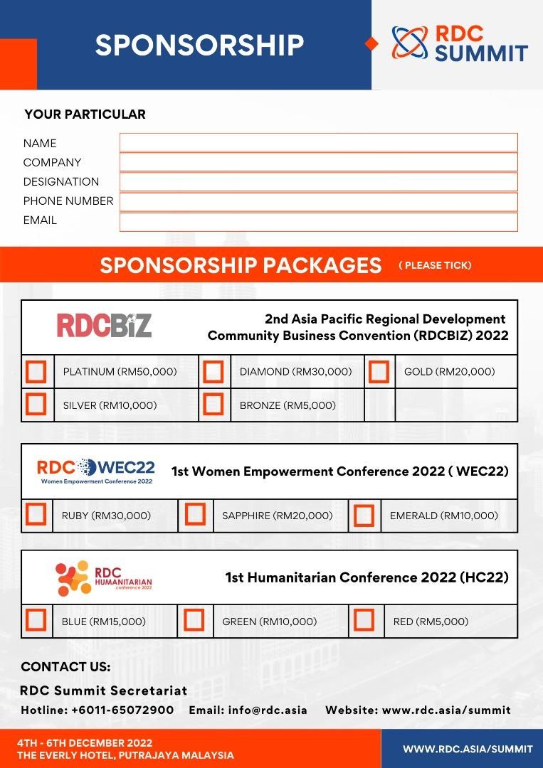
SPONSORSHIP FORM

